Slide 1

BATI
BIROUL DE AUDIT AL TIRAJELOR
SI INTERNETULUI
ONLINE AUDIENCE STUDY MOLDOVA
JUNE 2021

Slide 2
BATI
BIROUL DE AUDIT AL TIRAJELOR
SI INTERNETULUI
Agencies
in 2021 the study is conducted with the support of 3 major advertising agencies

Slide 3
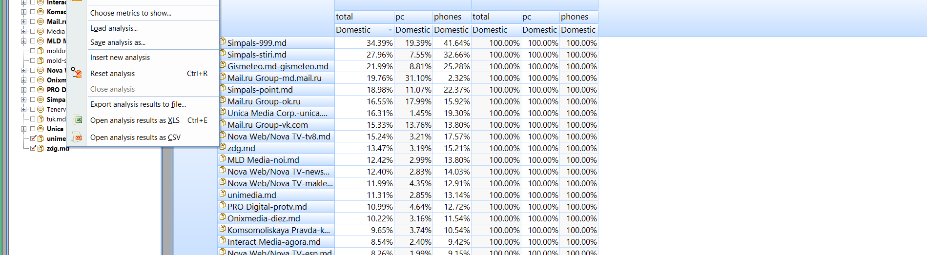





Agencies
BATI
BIROUL DE AUDIT AL TIRAJELOR
SI INTERNETULUI
How Online Media Influences Purchase Decisions

Slide 4

NOI.MD
AGORA.MD
MOLDOVENII.MD
EA.MD
ZDG.MD
KP.MD
NEWSMAKER.MD
MAKLER.MD
JURANALTV.MD
GISMETEO.MD
RUTUBE.RU
IVI.RU
MEGOGO.NET
MAIL.RU
OK.RU
ESP.MD
ANTICORUPTIE.MD
999.MD
POINT.MD
PROTV.MD
PERFECTE.MD
STIRI.MD
RISE.MD
MOLDOVA.ORG
TV8.MD
UNIMEDIA.MD
SPUTNIK.MD
JURNAL.MD
VK.COM
TUK.MD
UNICA.MD
ESP.MD
MOLD-STREET.COM
DIEZ.MD
SOCIAL MEDIA
BATI
BIROUL DE AUDIT AL TIRAJELOR
SI INTERNETULUI
83%
sites participating in the audience study REACH 83% of the .md internet population

Slide 5
1.843mln
MD INTERNET POPULATION
BATI
BIROUL DE AUDIT AL TIRAJELOR
SI INTERNETULUI
1.135mln
Usage of internet on a daily basis - PC
1.508mln
Usage of internet on a daily basis - MOBILE
Gender
AUDIENCE COMPOSITION
53%
47%

Slide 6
BATI
BIROUL DE AUDIT AL TIRAJELOR
SI INTERNETULUI
Gender
June 21

Slide 7
BATI
BIROUL DE AUDIT AL TIRAJELOR
SI INTERNETULUI
10%
29%
22%
16%
23%
15 – 19
20 – 29
30 – 39
40 – 49
50+
Age
AUDIENCE COMPOSITION

Slide 8
Age
15-19
20-29
20-29
30-49
50+
June 21

Slide 9
BATI
BIROUL DE AUDIT AL TIRAJELOR
SI INTERNETULUI
24%
20%
16%
Lyceum
Specialized
Middle
31%
9%
Education
AUDIENCE COMPOSITION
University
College

Slide 10
Education
Middle
Specialized
Lyceum
College
University
June 21

Slide 11
8%
21%
20%
Skilled worker
Student
Housewife/
Pensioner
BATI
BIROUL DE AUDIT AL TIRAJELOR
SI INTERNETULUI
13%
38%
Occupation
AUDIENCE COMPOSITION
CEO/Owner
Middle-grade manager

Slide 12
Occupation
Housewife/Pensioner
Student
Skilled worker
Middle-grade manager
CEO/Owner
June 21

Slide 13

BATI
BIROUL DE AUDIT AL TIRAJELOR
SI INTERNETULUI
Rural vs
Urban
online audience
58/42
58% URBAN 42% RURAL

Slide 14
Urban/Rural
Urban
Rural
June 21

Slide 15

Regions
North
28%
Center
27%
Chisinau
30%
South
11%
BATI
BIROUL DE AUDIT AL TIRAJELOR
SI INTERNETULUI
Gagauzia
5%
June 21

Slide 16
Regions
North
Center
Chisinau
South
Gagauzia
June 21

Slide 17
Household Net Income
01
03
11%
57%
MDL, monthly
16 – 30K
< 8K
4%
> 30K
28%
02
04
8 - 16K
BATI
BIROUL DE AUDIT AL TIRAJELOR
SI INTERNETULUI

Slide 18
Income
< 8 K
8- 16K
16 – 30K
> 30K
June 21

Slide 19
BATI
BIROUL DE AUDIT AL TIRAJELOR
SI INTERNETULUI
ONLINE
SHOPPERS
5%
INCREASE / YEAR
716K Online Buyers
BUY ONLINE A FEW TIMES A MONTH – 142K
BUY ALMOST EVERY MONTH – 177K
BUY A FEW TIMES A YEAR – 303K
BUY ONCE A YEAR – 94K
June 21

