Slide 1



FEBRUARY 2021
ONLINE AUDIENCE
STUDY REPORT
.MD INTERNET POPULATION - 1 843 327
MOBILE + DESKTOP

Slide 2


SEX
AUDIENCE COMPOSITION
SMTAI // FEBRUARY 20201

Slide 3

AGE
AUDIENCE COMPOSITION
SMTAI // FEBRUARY 20201

Slide 4

EDUCATION
AUDIENCE COMPOSITION
SMTAI // FEBRUARY 20201

Slide 5
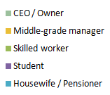
OCCUPATION
AUDIENCE COMPOSITION
SMTAI // FEBRUARY 20201

Slide 6


URBAN / RURAL
AUDIENCE COMPOSITION
SMTAI // FEBRUARY 20201

Slide 7

REGION
AUDIENCE COMPOSITION
SMTAI // FEBRUARY 20201

Slide 8
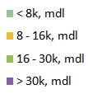
HOUSEHOLD NET INCOME
AUDIENCE COMPOSITION
SMTAI // FEBRUARY 20201

